Slide 1
Chapter 5: Advanced SQL

Slide 2
Chapter 5: Advanced SQL
Accessing SQL From a Programming Language
  Dynamic SQL
    JDBC and ODBC
  Embedded SQL
SQL Data Types and Schemas
Functions and Procedural Constructs
Triggers
Advanced Aggregation Features
OLAP

Slide 3
JDBC and ODBC
API (application-program interface) for a program to interact with a database server
Application makes calls to
  Connect with the database server
  Send SQL commands to the database server
  Fetch tuples of result one-by-one into program variables
ODBC (Open Database Connectivity) works with C, C++, C#, and Visual Basic
  Other API’s such as ADO.NET sit on top of ODBC
JDBC (Java Database Connectivity) works with Java

Slide 4
JDBC
JDBC is a Java API for communicating with database systems supporting SQL.
JDBC supports a variety of features for querying and updating data, and for retrieving query results.
JDBC also supports metadata retrieval, such as querying about relations present in the database and the names and types of relation attributes.
Model for communicating with the database:
  Open a connection
  Create a “statement” object
  Execute queries using the Statement object to send queries and fetch results
  Exception mechanism to handle errors

Slide 5
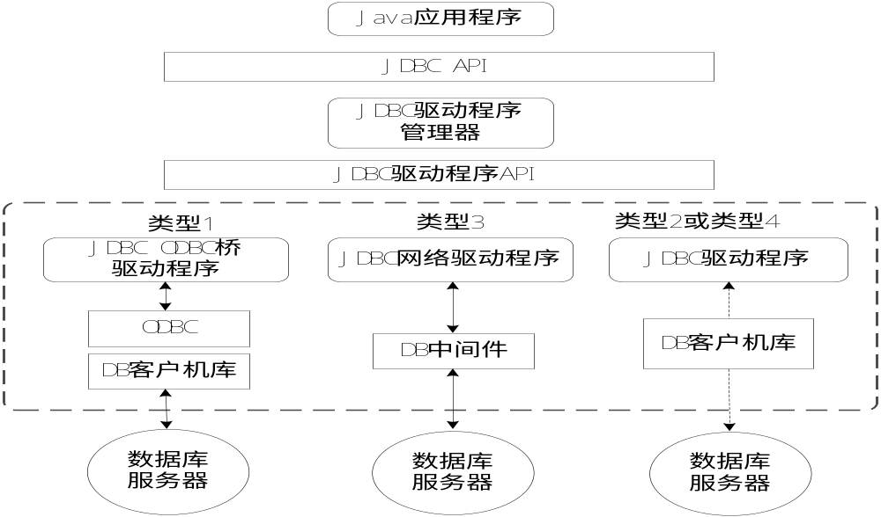
JDBC construct

Slide 6
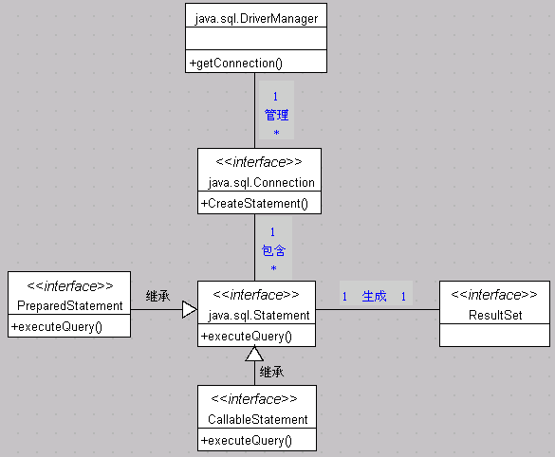
JDBC Core Package

Slide 7
JDBC API
java.sql.DriveManager负责装载、拆除驱动程序，负责连接驱动程序。
java.sql.Connection实现对某一数据库的连接功能（建立连接）。
java.sql.Statement 在一个给定的连接中作为执行SQL语句的容器。
java.sql.PreparedStatement用于执行预编译的SQL声明
java.sql.CallableStatement用于执行数据库中存储过程的调用
java.sql.ResultSet 保存SQL语句执行结果

Slide 8
1、Load JDBC Driver
在和某一特定数据库建立连接之前，必须首先加载一种可用的JDBC驱动程序。这需要使用java.sql包中的下列方法来加载JDBC驱动程序：
Class.forName("DriverName");
“DriverName”是要加载的JDBC驱动程序名称。驱动程序名称根据数据库厂商提供的JDBC驱动程序的种类来确定。加载Access数据库驱动程序的方法为：
Class.forName("sun.jdbc.odbc.JdbcOdbcDriver");

Slide 9
2、Create DB Connection
创建和指定数据库的连接需要使用DriverManager类的getConnection()方法，其一般的使用格式如下：
Connection conn = DriverManager.getConnection(URL,user,password);
该方法返回的是一个Connection对象。这里的URL是一个字符串，代表了将要连接的数据源，即具体的数据库位置。不同的JDBC驱动程序其URL是不同的。
通过ODBC连接数据库的例子如下：
Class.forName("sun.jdbc.ordc.JdbcOdbcDriver");
Connection Conn = DriverManager.getConnection("jdbc:odbc:jxgl”);

Slide 10
3、Execute SQL statement
在与某个特定数据库建立连接之后，连接会话就可以用于发送SQL语句。在发送SQL语句前，必须创建一个类的对象，该对象负责将SQL语句发送给数据库。
创建Statement对象是使用Connection接口的createStatement()方法来实现的：
Statement smt = conn.createStatement();
Statement对象创建好之后，就可以使用该对象的executeQuery()方法来执行数据库查询语句，executeQuery()方法返回一个ResultSet类的对象，它包含了SQL查询语句执行的结果。
ResultSet rs = smt.executeQuery("SELECT * FROM student");

Slide 11
4、Get Result
JDBC接收结果是通过ResultSet类的对象来实现的。一个ResultSet对象包含了执行某个SQL语句后满足条件的所有的行，它还提供了对这些行的访问，用户可以通过一组get方法来访问当前行的不同列。通常结果集的形式是一张带有表头和相应数值的表。

Slide 12
5、Close
一个Statement对象在同一时间只能打开一个结果集，所以如果在同一个Statement对象中运行下一条SQL语句时，第一条SQL语句生成的ResultSet对象就被自动关闭了。当然也可以通过调用ResultSet接口的close()方法来手工关闭。关闭Statement对象和Connection对象可以分别使用各自的close()方法。

Slide 13
Connection Interface
Statement createStatement() 创建用于执行SQL语句的Statement对象。
PreparedStatement prepareStatement(String sql)创建PrepareStatement对象，用于实现数据库的动态访问。
参数：sql —— 是SQL的INSERT，UPDATE和DELETE语句，或是无返回结果的语句。
void close() 结束Connection对象对数据库的连接。
boolean isClose() 测试是否已经关闭Connection对象对数据库的连接。

Slide 14
Statement Interface
Statement接口用于执行静态的SQL语句，静态的SQL语句在执行时不需要接收任何参数。其主要功能是将SQL语句传送给数据库，并将SQL语句的执行结果返回。
ResultSet executeQuery(String sql) ：执行SQL查询语句，返回满足条件的结果集。
参数：sql —— 是SQL的SELECT语句。
int executeUpdate(String sql) ：执行SQL数据更新语句，返回值为结果集中的记录数。
参数：sql —— 是SQL的INSERT，UPDATE和DELETE语句，或是无返回结果的语句。

Slide 15
Statement Interface(cont.)
boolean execute(String sql) ：执行任意SQL语句。如果第一个结果是ResultSet，则返回true；否则如果是整数型，则返回false
参数：sql —— 可以是任何SQL语句。
boolean getMoreResults() ：移动到Statement对象的下一结果处，用于返回多个结果的SQL语句。
void close() ：关闭当前的Statement对象。
通过Connection接口提供的createStatement()方法，可以建立Statement对象。当建立好Statement对象之后，就可以使用executeQuery()方法对数据库表中存储的数据进行查询以及使用executeUpdate()方法进行插入、修改和删除记录的操作。

Slide 16
Result Interface
ResultSet接口用于得到包含了执行SQL查询语句返回的结果集，这个结果集实质上就是一个二维数据表。要得到这张表中的任何一个字段项都需要先找到该字段项所处的行，再找到它所处的列。而完成这个工作要靠一个指向当前行的指针，开始它指向第一行，每调用一次next()方法，它就向下移动一行，到达目标行之后，就可以使用getXXX()方法得到目标的字段值。
boolean first() ：移动记录指针到第1个记录，返回布尔值。
boolean last() ：移动记录指针到最后1个记录，返回布尔值
boolean next() ：移动记录指针到下一个记录，返回布尔值
boolean previous() ：移动记录指针到上一个记录，返回布尔值

Slide 17
Result Interface
Boolean getBoolean(int CIndex) ：返回指定字段的以Java语言的booelan类型表示的字段值。
String getString(int CIndex) ：返回指定字段的以Java语言的String类型表示的字段值。
Int getInt(int CIndex) ：返回指定字段的以Java语言的int类型表示的字段值。
Long getLong(int CIndex) ：返回指定字段的以Java语言的long类型表示的字段值。
Float getFloat(int CIndex) ：返回指定字段的以Java语言的float类型表示的字段值。
Double getDouble(int CIndex)：返回指定字段的以Java语言的Double类型表示的字段值。
Date getDate(int CIndex) ：返回指定字段的以Java.sql.Date的Date类型表示的字段值

Slide 18
JDBC Code
  public static void JDBCexample(String dbid, String userid, String passwd)
{
  try {
    Class.forName ("oracle.jdbc.driver.OracleDriver");
    Connection conn = DriverManager.getConnection(
    "jdbc:oracle:thin:@db.yale.edu:2000:univdb", userid, passwd);
  Statement stmt = conn.createStatement();
  … Do Actual Work ….
  stmt.close();
  conn.close();
  }
  catch (SQLException sqle) {
  System.out.println("SQLException : " + sqle);
  }
}

Slide 19
JDBC Code (Cont.)
Update to database
try {
stmt.executeUpdate(
"insert into instructor values(’77987’, ’Kim’, ’Physics’, 98000)");
} catch (SQLException sqle)
{
System.out.println("Could not insert tuple. " + sqle);
}
Execute query and fetch and print results
  ResultSet rset = stmt.executeQuery(
  "select dept_name, avg (salary)
  from instructor
  group by dept_name");
  while (rset.next()) {
  System.out.println(rset.getString("dept_name") + " " +
  rset.getFloat(2));
  }

Slide 20
JDBC Code Details
Getting result fields:
  rs.getString(“dept_name”) and rs.getString(1) equivalent if dept_name is the first argument of select result.
Dealing with Null values
  int a = rs.getInt(“a”);
  if (rs.wasNull()) // 判断是否为空值
  Systems.out.println(“Got null value”);

Slide 21
SQL Injection
Suppose query is constructed using
  "select * from instructor where name = ’" + name + "’"
Suppose the user, instead of entering a name, enters:
  X’ or ’Y’ = ’Y
then the resulting statement becomes:
  "select * from instructor where name = ’" + "X’ or ’Y’ = ’Y" + "’"
  which is:
    select * from instructor where name = ’X’ or ’Y’ = ’Y’
  User could have even used
    X’; update instructor set salary = salary + 10000; --
Prepared statement internally uses:
"select * from instructor where name = ’X\’ or \’Y\’ = \’Y’
  Always use prepared statements, with user inputs as parameters

Slide 22
Prepared Statement
PreparedStatement pStmt = conn.prepareStatement(
"insert into instructor values(?,?,?,?)");
pStmt.setString(1, "88877"); pStmt.setString(2, "Perry");
pStmt.setString(3, "Finance"); pStmt.setInt(4, 125000);
pStmt.executeUpdate();
pStmt.setString(1, "88878");
pStmt.executeUpdate();
For queries, use pStmt.executeQuery(), which returns a ResultSet
WARNING: always use prepared statements when taking an input from the user and adding it to a query
  NEVER create a query by concatenating strings which you get as inputs
  "insert into instructor values(’ " + ID + " ’, ’ " + name + " ’, " +
  " ’ + dept name + " ’, " ’ balance + ")“
  What if name is “D’Souza”?

Slide 23
Metadata Features
ResultSet metadata
E.g., after executing query to get a ResultSet rs:
  ResultSetMetaData rsmd = rs.getMetaData();
  for(int i = 1; i <= rsmd.getColumnCount(); i++)
  {
  System.out.println(rsmd.getColumnName(i));
System.out.println(rsmd.getColumnTypeName(i));
}
How is this useful?

Slide 24
Metadata (Cont)
Database metadata
DatabaseMetaData dbmd = conn.getMetaData();
ResultSet rs = dbmd.getColumns(null, "univdb", "department", "%");
// Arguments to getColumns: Catalog, Schema-pattern, Table-pattern,
// and Column-Pattern
// Returns: One row for each column; row has a number of attributes
// such as COLUMN_NAME, TYPE_NAME
while( rs.next()) {
System.out.println(rs.getString("COLUMN_NAME"),
rs.getString("TYPE_NAME");
}
And where is this useful?

Slide 25
Transaction Control in JDBC
By default, each SQL statement is treated as a separate transaction that is committed automatically
  bad idea for transactions with multiple updates
Can turn off automatic commit on a connection
  conn.setAutoCommit(false);
Transactions must then be committed or rolled back explicitly
  conn.commit(); or
  conn.rollback();
conn.setAutoCommit(true) turns on automatic commit.

Slide 26
Other JDBC Features
Calling functions and procedures
  CallableStatement cStmt1 = conn.prepareCall("{? = call some function(?)}");
  CallableStatement cStmt2 = conn.prepareCall("{call some procedure(?,?)}");
Handling large object types
  getBlob() and getClob() that are similar to the getString() method, but return objects of type Blob and Clob, respectively
  get data from these objects by getBytes()
  associate an open stream with Java Blob or Clob object to update large objects
    blob.setBlob(int parameterIndex, InputStream inputStream).

Slide 27
SQLJ
JDBC is overly dynamic, errors cannot be caught by compiler
SQLJ: embedded SQL in Java
  #sql iterator deptInfoIter ( String dept name, int avgSal);
  deptInfoIter iter = null;
  #sql iter = { select dept_name, avg(salary) from instructor
  group by dept name };
  while (iter.next()) {
  String deptName = iter.dept_name();
  int avgSal = iter.avgSal();
  System.out.println(deptName + " " + avgSal);
  }
  iter.close();

Slide 28
ODBC
Open DataBase Connectivity(ODBC) standard
  standard for application program to communicate with a database server.
  application program interface (API) to
    open a connection with a database,
    send queries and updates,
    get back results.
Applications such as GUI, spreadsheets, etc. can use ODBC
Was defined originally for Basic and C, versions available for many languages.

Slide 29
ODBC (Cont.)
Each database system supporting ODBC provides a "driver" library that must be linked with the client program.
When client program makes an ODBC API call, the code in the library communicates with the server to carry out the requested action, and fetch results.
ODBC program first allocates an SQL environment, then a database connection handle.
Opens database connection using SQLConnect(). Parameters for SQLConnect:
  connection handle,
  the server to which to connect
  the user identifier,
  password
Must also specify types of arguments:
  SQL_NTS denotes previous argument is a null-terminated string.

Slide 30
ODBC Architecture
Data Source
Name
Database application programs
Application
Level
ODBC API
ODBC manager
ODBC
Level
ODBC driver manager
SQL Server
driver
Oracle
driver
Sybase
driver
other DB
driver
SQL
Server
Oracle
Sybase
other
DBMS
Data Source
Level

Slide 31
ODBC Code
int ODBCexample()
{
  RETCODE error;
  HENV env; /* environment */
  HDBC conn; /* database connection */
  SQLAllocEnv(&env); //分配环境
  SQLAllocConnect(env, &conn); //分配连接
  SQLConnect(conn, “db.yale.edu”, SQL_NTS, “avi”, SQL_NTS, “avipasswd”, SQL_NTS); //链接
  { …. Do actual work … }
  SQLDisconnect(conn);
  SQLFreeConnect(conn);
  SQLFreeEnv(env);
}

Slide 32
ODBC Code (Cont.)
Program sends SQL commands to database by using SQLExecDirect
Result tuples are fetched using SQLFetch()
SQLBindCol() binds C language variables to attributes of the query result
  When a tuple is fetched, its attribute values are automatically stored in corresponding C variables.
  Arguments to SQLBindCol()
    ODBC stmt variable, attribute position in query result
    The type conversion from SQL to C.
    The address of the variable.
    For variable-length types like character arrays,
      The maximum length of the variable
      Location to store actual length when a tuple is fetched.
      Note: A negative value returned for the length field indicates null value
Good programming requires checking results of every function call for errors; we have omitted most checks for brevity.

Slide 33
ODBC Code (Cont.)
Main body of program
  char deptname[80];
  float salary;
  int lenOut1, lenOut2;
  HSTMT stmt;
  char * sqlquery = "select dept_name, sum (salary)
  from instructor
  group by dept_name";
  SQLAllocStmt(conn, &stmt);
  error = SQLExecDirect(stmt, sqlquery, SQL_NTS);
  if (error == SQL SUCCESS) {
  SQLBindCol(stmt, 1, SQL_C_CHAR, deptname , 80, &lenOut1);
  SQLBindCol(stmt, 2, SQL_C_FLOAT, &salary, 0 , &lenOut2);
  while (SQLFetch(stmt) == SQL_SUCCESS) {
  printf (" %s %g\n", deptname, salary);
  }
  }
  SQLFreeStmt(stmt, SQL_DROP);

Slide 34
ODBC Prepared Statements
Prepared Statement
  SQL statement prepared: compiled at the database
  Can have placeholders: E.g. insert into account values(?,?,?)
  Repeatedly executed with actual values for the placeholders
To prepare a statement
SQLPrepare(stmt, <SQL String>);
To bind parameters
SQLBindParameter(stmt, <parameter#>,
… type information and value omitted for simplicity..)
To execute the statement
retcode = SQLExecute( stmt);
To avoid SQL injection security risk, do not create SQL strings directly using user input; instead use prepared statements to bind user inputs

Slide 35
More ODBC Features
Metadata features
  finding all the relations in the database and
  finding the names and types of columns of a query result or a relation in the database.
By default, each SQL statement is treated as a separate transaction that is committed automatically.
  Can turn off automatic commit on a connection
    SQLSetConnectOption(conn, SQL_AUTOCOMMIT, 0)}
  Transactions must then be committed or rolled back explicitly by
    SQLTransact(conn, SQL_COMMIT) or
    SQLTransact(conn, SQL_ROLLBACK)

Slide 36
ODBC Conformance Levels
Conformance levels specify subsets of the functionality defined by the standard.
  Core
  Level 1 requires support for metadata querying
  Level 2 requires ability to send and retrieve arrays of parameter values and more detailed catalog information.
SQL Call Level Interface (CLI) standard similar to ODBC interface, but with some minor differences.

Slide 37
ADO.NET
API designed for Visual Basic .NET and C#, providing database access facilities similar to JDBC/ODBC
  Partial example of ADO.NET code in C#
  using System, System.Data, System.Data.SqlClient;
  SqlConnection conn = new SqlConnection(
  “Data Source=<IPaddr>, Initial Catalog=<Catalog>”);
  conn.Open();
  SqlCommand cmd = new SqlCommand(“select * from students”,
  conn);
  SqlDataReader rdr = cmd.ExecuteReader();
  while(rdr.Read()) {
  Console.WriteLine(rdr[0], rdr[1]); /* Prints result attributes 1 & 2 */
  }
  rdr.Close(); conn.Close();
Can also access non-relational data sources such as
  OLE-DB, XML data, Entity framework

Slide 38
Embedded SQL
The SQL standard defines embeddings of SQL in a variety of programming languages such as C, Java, and Cobol.
A language to which SQL queries are embedded is referred to as a host language, and the SQL structures permitted in the host language comprise embedded SQL.
The basic form of these languages follows that of the System R embedding of SQL into PL/I.
  Programs written in the host language can use the embedded SQL syntax to access and update stored in a database. This embedded form of SQL extends the programmer’s ability to manipulate the database even further. In embedded SQL, all query processing is performed by the database system, which then makes the result of the query available to the program one tuple at a time.

Slide 39
Embedded SQL
The communications between embedded SQL statements and host language
  SQLCA(SQL communication-area, SQL通信区): pass the execution state information of SQL statements to host language, such that host language may control the program flow.
SQLCA is a declared memory structure, containing member variables used to communicate information between the database monitor and the program.
In a program, EXEC SQL INCLUDE SQLCA statement is used to defined SQLCA.

Slide 40
Embedded SQL
The communications between embedded SQL statements and host language
  Host variable(主变量): is used to provide parameters to SQL statement from host language and submit the results of SQL statements to host language.
Host variable is a normal program variable.
The colon (:) must always precedes host variables, when they are used in Embedded SQL statements.
In order to use these host variables in an Embedded SQL statement, they must first be declared, including a declaration to the precompiler.
Host variables used in Embedded SQL statements should have dataypes that are known to the database system.

Slide 41
Embedded SQL
The communications between embedded SQL statements and host language
  Cursor(游标): is used to submit the results of SQL statements to host language for further process.
As we perform a SELECT on an unknown number of rows, retrieving the rows one at a time, we need a cursor to keep track of where we are.
A declare CURSOR statement is a declaration in the usual sense, and it is usually placed early in a program. After the cursor has been declared, it is still not in active use.
Before the program can begin to retrieve information, an Embedded SQL statement must be executed to open the cursor. After the cursor is open, the program can then retrieve one row at a time from the cursor using a fetch operation; when the program is finished fetching, it should close the cursor once again.

Slide 42
Cursor in Embedded SQL (cont.)
Usage of cursor in embedded SQL
declare cursor – open – fetch - close
application program:
open
fetch
close
SQL query
cursor
working area
DBS
results
…
Fig. Cursor in Embedded SQL

Slide 43
Example Query
From within a host language, find the ID and name of students who have completed more than the number of credits stored in variable credit_amount.
Specify the query in SQL and declare a cursor for it
EXEC SQL
declare c cursor for
select ID, name
from student
where tot_cred > :credit_amount
END_EXEC
结果是集合，游标c指向其中当前元组

Slide 44
Embedded SQL (Cont.)
The open statement causes the query to be evaluated
EXEC SQL open c END_EXEC
The fetch statement causes the values of one tuple in the query result to be placed on host language variables.
EXEC SQL fetch c into :si, :sn END_EXEC
Repeated calls to fetch get successive tuples in the query result
A variable called SQLSTATE in the SQL communication area (SQLCA) gets set to ‘02000’ to indicate no more data is available
The close statement causes the database system to delete the temporary relation that holds the result of the query.
EXEC SQL close c END_EXEC
Note: above details vary with language. For example, the Java embedding defines Java iterators to step through result tuples.

Slide 45
Updates Through Cursors
Can update tuples fetched by cursor by declaring that the cursor is for update
declare c cursor for
select *
from instructor
where dept_name = ‘Music’
for update
To update tuple at the current location of cursor c
update instructor
set salary = salary + 100
where current of c

Slide 46
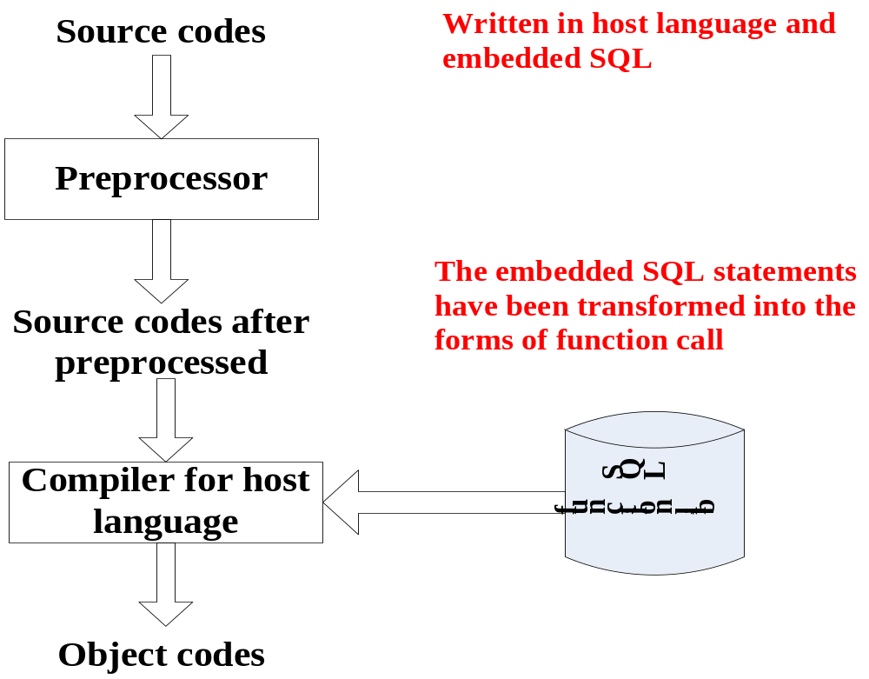
Embedded SQL
The implementation Process of embedded SQL

Slide 47
#include<stdio.h> #include “prompt.h” 1 EXEC SQL INCLUDE SQLCA; 2 char cid_promt[] = “Please enter customer id:”; 3 int main(){ 4 EXEC SQL BEGIN DECLARE SECTION; 5 char cust_id[5],cust_name[14]; 6 float cust_discnt; 7 char user_name[20], user_pwd[20]; 8 EXEC SQL END DECLARE SECTION; 9 EXEC SQL WHENEVER SQLERROR goto report_error; 10 EXEC SQL WHENEVER NOT FOUND goto notfound; 11 strcpy(user_name, “poneilsql”); 12 strcpy(user_pwd, “XXXX”); 13 EXEC SQL CONNECT:user_name IDENTIFIED BY :user_pwd; 14 while((prompt(cid_prompt,1,cust_id,4)) >= 0){ 15 EXEC SQL SELECT cname, discnt INTO :cust_name,:cust_discnt FROM CUSTOMERS WHERE cid=:cust_id; 16 EXEC SQL COMMIT WORK; 17 printf(“Name: %s, discount: %5.1f”,cust_name,cust_discnt); 18 continue; 19 notfound: printf(“cannot find customer: %s”, cust_name); 20 }
21 EXEC SQL COMMIT RELEASE; 22 return 0; 23 report_error: 24 print_dberror(); 25 EXEC SQL ROLLBACK RELEASE; 26 return 1; 27}

Slide 48
#define TRUE 1 #include <stdio.h> #include “prompt.h” 1 EXEC SQL INCLUDE SQLCA; 2 EXEC SQL BEGIN DECLARE section; 3 char cust_id[5], agent_id[4]; 4 double dollar_sum; 5 EXEC SQL END DECLARE section; 6 int main(){ 7 char cid_prompt[] = "Please enter customer ID: "; 8 EXEC SQL DECLARE agent_dollars cursor for 9 SELECT aid, sum(dollars) FROM ORDERS 10 WHERE cid=:cust_id GROUP BY aid; 11 EXEC SQL WHENEVER SQLERROR goto report_error; 12 EXEC SQL CONNECT TO testdb; 13 EXEC SQL WHENEVER NOT FOUND goto finish; 14 while(prompt(cid_prompt, 1, cust_id, 4) >= 0){ 15 EXEC SQL OPEN agent_dollars; 16 while(true) { 17 EXEC SQL FETCH agent_dollars INTO:agent_id, :dollar_sum; 18 printf("%s %11.2f\n", agent_id, dollar_sum); 19 }
20 finish: EXEC SQL CLOSE agent_dollars; 21 EXEC SQL COMMIT work; 22 } 23 EXEC SQL DISCONNECT current; 24 return 0; 25 report_error: 26 print_dberror(); 27 EXEC SQL ROLLBACK RELEASE; 28 EXEC SQL DISCONNECT current; 29 return 1; 30}

Slide 49
Procedural Constructs in SQL

Slide 50
Procedural Extensions and Stored Procedures
SQL provides a module language
  Permits definition of procedures in SQL, with if-then-else statements, for and while loops, etc.
Stored Procedures
  Can store procedures in the database
  then execute them using the call statement
  permit external applications to operate on the database without knowing about internal details
Object-oriented aspects of these features are covered in Chapter 22 (Object Based Databases)

Slide 51
Functions and Procedures
SQL:1999 supports functions and procedures
  Functions/procedures can be written in SQL itself, or in an external programming language.
  Functions are particularly useful with specialized data types such as images and geometric objects.
    Example: functions to check if polygons overlap, or to compare images for similarity.
  Some database systems support table-valued functions, which can return a relation as a result.
SQL:1999 also supports a rich set of imperative constructs, including
  Loops, if-then-else, assignment
Many databases have proprietary procedural extensions to SQL that differ from SQL:1999.

Slide 52
SQL Functions
Define a function that, given the name of a department, returns the count of the number of instructors in that department.
create function dept_count (dept_name varchar(20))
returns integer
begin
declare d_count integer;
select count (* ) into d_count
from instructor
where instructor.dept_name = dept_name
return d_count;
end
Find the department name and budget of all departments with more that 12 instructors.
select dept_name, budget
from department
where dept_count (dept_name ) > 1

Slide 53
Table Functions
SQL:2003 added functions that return a relation as a result
Example: Return all accounts owned by a given customer
create function instructors_of (dept_name char(20)
returns table ( ID varchar(5),
name varchar(20),
dept_name varchar(20),
salary numeric(8,2))
return table
(select ID, name, dept_name, salary
from instructor
where instructor.dept_name = instructors_of.dept_name)
Usage
select *
from table (instructors_of (‘Music’))

Slide 54
SQL Procedures
The dept_count function could instead be written as procedure:
create procedure dept_count_proc (in dept_name varchar(20),
out d_count integer)
begin
select count(*) into d_count
from instructor
where instructor.dept_name = dept_count_proc.dept_name
end
Procedures can be invoked either from an SQL procedure or from embedded SQL, using the call statement.
declare d_count integer;
call dept_count_proc( ‘Physics’, d_count);
Procedures and functions can be invoked also from dynamic SQL
SQL:1999 allows more than one function/procedure of the same name (called name overloading), as long as the number of
arguments differ, or at least the types of the arguments differ

Slide 55
Procedural Constructs
Warning: most database systems implement their own variant of the standard syntax below
  read your system manual to see what works on your system
Compound statement: begin … end,
  May contain multiple SQL statements between begin and end.
  Local variables can be declared within a compound statements
Whileand repeat statements :
declare n integer default 0;
while n < 10 do
  set n = n + 1
end while
repeat
  set n = n – 1
until n = 0
end repeat

Slide 56
Procedural Constructs (Cont.)
For loop
  Permits iteration over all results of a query
  Example:
  declare n integer default 0;
  for r as
  select budget from department
  where dept_name = ‘Music’
  do
  set n = n + r.budget
  end for

Slide 57
Procedural Constructs (cont.)
Conditional statements (if-then-else)
SQL:1999 also supports a case statement similar to C case statement
Example procedure: registers student after ensuring classroom capacity is not exceeded
  Returns 0 on success and -1 if capacity is exceeded
  See book for details(next slide)
Signaling of exception conditions, and declaring handlers for exceptions
declare out_of_classroom_seats condition
declare exit handler for out_of_classroom_seats
begin
…
.. signal out_of_classroom_seats
end
  The handler here is exit -- causes enclosing begin..end to be exited
  Other actions possible on exception

Slide 58
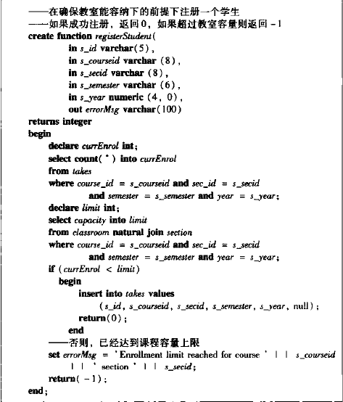

Slide 59
External Language Functions/Procedures
SQL:1999 permits the use of functions and procedures written in other languages such as C or C++
Declaring external language procedures and functions
create procedure dept_count_proc(in dept_name varchar(20),
out count integer)
language C
external name ’ /usr/avi/bin/dept_count_proc’
create function dept_count(dept_name varchar(20))
returns integer
language C
external name ‘/usr/avi/bin/dept_count’

Slide 60
External Language Routines (Cont.)
Benefits of external language functions/procedures:
  more efficient for many operations, and more expressive power.
Drawbacks
  Code to implement function may need to be loaded into database system and executed in the database system’s address space.
    risk of accidental corruption of database structures
    security risk, allowing users access to unauthorized data
  There are alternatives, which give good security at the cost of potentially worse performance.
  Direct execution in the database system’s space is used when efficiency is more important than security.

Slide 61
Security with External Language Routines
To deal with security problems
  Use sandbox techniques
    that is use a safe language like Java, which cannot be used to access/damage other parts of the database code.
  Or, run external language functions/procedures in a separate process, with no access to the database process’ memory.
    Parameters and results communicated via inter-process communication
Both have performance overheads
Many database systems support both above approaches as well as direct executing in database system address space.

Slide 62
Triggers

Slide 63
Triggers
Triggers are part of the database schema
A Trigger is a series of actions that are associated with certain events, such as insertions into a particular relation, and that are performed whenever these events arise.
A trigger is a statement that is executed automatically by the system as a side effect of a modification to the database.
A trigger is a database object stored in some relation. When certain event happens, a sequence of operations is triggered.
To design a trigger mechanism, we must:
  Specify the conditions under which the trigger is to be executed.
  Specify the actions to be taken when the trigger executes.
Triggers introduced to SQL standard in SQL:1999, but supported even earlier using non-standard syntax by most databases.

Slide 64
Triggers
Trigger are only awakened when certain events occur. The sorts of events allowed are usually insert, delete, or update to a particular relation.
Once awakened by its triggering event, the trigger tests a condition. If the condition does not hold, then nothing else associated with the trigger happens in response to this event.
If the condition of the trigger is satisfied, the action associated with the trigger is performed by the DBMS. A possible action is to modify the effects of the event in some way, even aborting the transaction of which the event is part.

Slide 65
Triggers
Triggers in SQL
Event-Condition-Action Rules
CREATE TRIGGER name {BEFORE|AFTER}
{ event [ OR ... ]}
ON table [FOR [EACH]{ROW|STATEMENT } ]
Action
触发条件
  event：INSERT，UPDATE 或 DELETE 操作
  BEFORE|AFTER 之前或之后
  FOR EACH ROW 执行指定操作的触发器为操作修改的每一行都调用一次。行级触发器
  FOR EACH STATEMENT 的触发器只是为任何操作执行一次，不管有多少行被修改。语句级触发器

Slide 66
Trigger Example
E.g. time_slot_id is not a primary key of timeslot, so we cannot create a foreign key constraint from section to timeslot.
Alternative: use triggers on section and timeslot to enforce integrity constraints
create trigger timeslot_check1 after insert on section
referencing new row as nrow
for each row
when (nrow.time_slot_id not in (
select time_slot_id
from time_slot)) /* time_slot_id not present in time_slot */
begin
rollback
end;
触发器名
触发事件
对每个修改的行执行一次

Slide 67
Trigger Example Cont.
create trigger timeslot_check2 after delete on timeslot
referencing old row as orow
for each row
when (orow.time_slot_id not in (
select time_slot_id
from time_slot)
/* last tuple for time slot id deleted from time slot */
and orow.time_slot_id in (
select time_slot_id
from section)) /* and time_slot_id still referenced from section*/
begin
rollback
end;

Slide 68
Triggering Events and Actions in SQL
Triggering event can be insert, delete or update
Triggers on update can be restricted to specific attributes
  E.g., after update of takes on grade
Values of attributes before and after an update can be referenced
  referencing old row as : for deletes and updates
  referencing new row as : for inserts and updates
Triggers can be activated before an event, which can serve as extra constraints. E.g. convert blank grades to null.
create trigger setnull_trigger before update of takes
referencing new row as nrow
for each row
when (nrow.grade = ‘ ‘)
begin atomic
set nrow.grade = null;
end;

Slide 69
Trigger to Maintain credits_earned value
create trigger credits_earned after update of takes on (grade)
referencing new row as nrow
referencing old row as orow
for each row
//takes元组grade从 F或null变化触发
when nrow.grade <> ’F’ and nrow.grade is not null
and (orow.grade = ’F’ or orow.grade is null)
begin atomic
update student
set tot_cred= tot_cred +
(select credits
from course
where course.course_id= nrow.course_id)
where student.id = nrow.id;
end;

Slide 70
Statement Level Triggers
Instead of executing a separate action for each affected row, a single action can be executed for all rows affected by a transaction
  Use for each statement instead of for each row
  Use referencing old table or referencing new table to refer to temporary tables (called transition tables) containing the affected rows
  Can be more efficient when dealing with SQL statements that update a large number of rows
  例如,在Instructor表上创建一个AFTER UPDATE触发器，触发事件是UPDATE语句：
  UPDATE Instructor SET dept_name=‘Comp.Sci.’;
  假设表Instructor有1000行
    如果是语句级触发器，那么执行完该语句后，触发动作只发生一次
    如果是行级触发器，触发动作将执行1000次

Slide 71
When Not To Use Triggers
Triggers were used earlier for tasks such as
  maintaining summary data (e.g., total salary of each department)
  Replicating databases by recording changes to special relations (called change or delta relations) and having a separate process that applies the changes over to a replica
There are better ways of doing these now:
  Databases today provide built in materialized view facilities to maintain summary data
  Databases provide built-in support for replication
Encapsulation facilities can be used instead of triggers in many cases
  Define methods to update fields
  Carry out actions as part of the update methods instead of
  through a trigger

Slide 72
When Not To Use Triggers
Risk of unintended execution of triggers, for example, when
  loading data from a backup copy
  replicating updates at a remote site
  Trigger execution can be disabled before such actions.
Other risks with triggers:
  Error leading to failure of critical transactions that set off the trigger
  Cascading execution

Slide 73
Recursive Queries

Slide 74
Recursion in SQL
SQL:1999 permits recursive view definition
Example: find which courses are a prerequisite, whether directly or indirectly, for a specific course
with recursive rec_prereq(course_id, prereq_id) as (
select course_id, prereq_id
from prereq
union
select rec_prereq.course_id, prereq.prereq_id,
from rec_rereq, prereq
where rec_prereq.prereq_id = prereq.course_id
)
select ∗
from rec_prereq;
This example view, rec_prereq, is called the transitive closure of the prereq relation
Note: 1st printing of 6th ed erroneously used c_prereq in place of
rec_prereq in some places

Slide 75
The Power of Recursion
Recursive views make it possible to write queries, such as transitive closure queries, that cannot be written without recursion or iteration.
  Intuition: Without recursion, a non-recursive non-iterative program can perform only a fixed number of joins of prereq with itself
    This can give only a fixed number of levels of managers
    Given a fixed non-recursive query, we can construct a database with a greater number of levels of prerequisites on which the query will not work
    Alternative: write a procedure to iterate as many times as required
      See procedure findAllPrereqs in book

Slide 76
The Power of Recursion
Computing transitive closure using iteration, adding successive tuples to rec_prereq
  The next slide shows a prereq relation
  Each step of the iterative process constructs an extended version of rec_prereq from its recursive definition.
  The final result is called the fixed point of the recursive view definition.
Recursive views are required to be monotonic. That is, if we add tuples to prereq the view rec_prereq contains all of the tuples it contained before, plus possibly more

Slide 77


Example of Fixed-Point Computation

Slide 78
Advanced Aggregation Features

Slide 79
Ranking
Ranking is done in conjunction with an order by specification.
Suppose we are given a relation
student_grades(ID, GPA)
giving the grade-point average of each student
Find the rank of each student.
select ID, rank() over (order by GPA desc) as s_rank
from student_grades
An extra order by clause is needed to get them in sorted order
select ID, rank() over (order by GPA desc) as s_rank
from student_grades
order by s_rank
Ranking may leave gaps: e.g. if 2 students have the same top GPA, both have rank 1, and the next rank is 3
  dense_rank does not leave gaps, so next dense rank would be 2

Slide 80
Ranking
Ranking can be done using basic SQL aggregation, but resultant query is very inefficient
  select ID, (1 + (select count(*)
  from student_grades B
  where B.GPA > A.GPA)) as s_rank
  from student_grades A
  order by s_rank;

Slide 81
Ranking (Cont.)
Ranking can be done within partition of the data.
“Find the rank of students within each department.”
select ID, dept_name,
rank () over (partition by dept_name order by GPA desc)
as dept_rank
from dept_grades
order by dept_name, dept_rank;
Multiple rank clauses can occur in a single select clause.
Ranking is done after applying group by clause/aggregation
Can be used to find top-n results
  More general than the limit n clause supported by many databases, since it allows top-n within each partition

Slide 82
Ranking (Cont.)
Other ranking functions:
  percent_rank (within partition, if partitioning is done)
  cume_dist (cumulative distribution)
    fraction of tuples with preceding values
  row_number (non-deterministic in presence of duplicates)
SQL:1999 permits the user to specify nulls first or nulls last
select ID,
rank ( ) over (order by GPA desc nulls last) as s_rank
from student_grades

Slide 83
Ranking (Cont.)
For a given constant n, the ranking the function ntile(n) takes the tuples in each partition in the specified order, and divides them into n buckets with equal numbers of tuples.
E.g.,
select ID, ntile(4) over (order by GPA desc) as quartile
from student_grades;

Slide 84
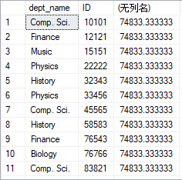
Windowing
select dept_name, ID, avg (salary)
from instructor
group by dept_name; /* erroneous query */
select dept_name, ID, avg (salary) over() from instructor

Slide 85
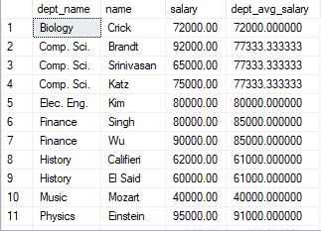
Windowing
select dept_name,name, salary,avg (salary) over(PARTITION by dept_name) as dept_avg_salary from instructor ;
note:partition by 分组

Slide 86
Windowing
Used to smooth out random variations.
E.g., moving average: “Given sales values for each date, calculate for each date the average of the sales on that day, the previous day, and the next day”
Window specification in SQL:
  Given relation sales(date, value)
select date, sum(value) over
(order by date between rows 1 preceding and 1 following)
from sales

Slide 87
Windowing
Examples of other window specifications:
  between rows unbounded preceding and current
  rows unbounded preceding
  range between 10 preceding and current row
    All rows with values between current row value –10 to current value
  range interval 10 day preceding
    Not including current row

Slide 88
Windowing (Cont.)
Can do windowing within partitions
E.g., Given a relation transaction (account_number, date_time, value), where value is positive for a deposit and negative for a withdrawal
  “Find total balance of each account after each transaction on the account”
  select account_number, date_time,
  sum (value) over
  (partition by account_number
  order by date_time
  rows unbounded preceding)
  as balance
  from transaction
  order by account_number, date_time

Slide 89
OLAP**

Slide 90
Data Analysis and OLAP
Online Analytical Processing (OLAP)
  Interactive analysis of data, allowing data to be summarized and viewed in different ways in an online fashion (with negligible delay)
Data that can be modeled as dimension attributes and measure attributes are called multidimensional data.
  Measure attributes
    measure some value
    can be aggregated upon
    e.g., the attribute number of the sales relation
  Dimension attributes
    define the dimensions on which measure attributes (or aggregates thereof) are viewed
    e.g., attributes item_name, color, and size of the sales relation

Slide 91

Example sales relation
...
...
...
...
...
...
...
...

Slide 92

Cross Tabulation of sales by item_name and color
The table above is an example of a cross-tabulation (cross-tab), also referred to as a pivot-table.
  Values for one of the dimension attributes form the row headers
  Values for another dimension attribute form the column headers
  Other dimension attributes are listed on top
  Values in individual cells are (aggregates of) the values of the
  dimension attributes that specify the cell.

Slide 93

Data Cube
A data cube is a multidimensional generalization of a cross-tab
Can have n dimensions; we show 3 below
Cross-tabs can be used as views on a data cube

Slide 94

Hierarchies on Dimensions
Hierarchy on dimension attributes: lets dimensions to be viewed at different levels of detail
  E.g., the dimension DateTime can be used to aggregate by hour of day, date, day of week, month, quarter or year

Slide 95

Cross Tabulation With Hierarchy
Cross-tabs can be easily extended to deal with hierarchies
  Can drill down or roll up on a hierarchy

Slide 96

Relational Representation of Cross-tabs
Cross-tabs can be represented as relations
  We use the value all is used to represent aggregates.
  The SQL standard actually uses null values in place of all despite confusion with regular null values.

Slide 97
Extended Aggregation to Support OLAP
The cube operation computes union of group by’s on every subset of the specified attributes
Example relation for this section
sales(item_name, color, clothes_size, quantity)
E.g. consider the query
select item_name, color, size, sum(number)
from sales
group by cube(item_name, color, size)
This computes the union of eight different groupings of the sales relation:
{ (item_name, color, size), (item_name, color),
(item_name, size), (color, size),
(item_name), (color),
(size), ( ) }
where ( ) denotes an empty group by list.
For each grouping, the result contains the null value
for attributes not present in the grouping.

Slide 98
Online Analytical Processing Operations
Relational representation of cross-tab that we saw earlier, but with null in place of all, can be computed by
select item_name, color, sum(number)
from sales
group by cube(item_name, color)
The function grouping() can be applied on an attribute
  Returns 1 if the value is a null value representing all, and returns 0 in all other cases.
select item_name, color, size, sum(number),
grouping(item_name) as item_name_flag,
grouping(color) as color_flag,
grouping(size) as size_flag,
from sales
group by cube(item_name, color, size)

Slide 99
Online Analytical Processing Operations
Can use the function decode() in the select clause to replace
such nulls by a value such as all
  E.g., replace item_name in first query by
  decode( grouping(item_name), 1, ‘all’, item_name)

Slide 100
Extended Aggregation (Cont.)
The rollup construct generates union on every prefix of specified list of attributes
E.g.,
select item_name, color, size, sum(number)
from sales
group by rollup(item_name, color, size)
  Generates union of four groupings:
{ (item_name, color, size), (item_name, color), (item_name), ( ) }
Rollup can be used to generate aggregates at multiple levels of a
hierarchy.
E.g., suppose table itemcategory(item_name, category) gives the category of each item. Then
select category, item_name, sum(number)
from sales, itemcategory
where sales.item_name = itemcategory.item_name
group by rollup(category, item_name)
would give a hierarchical summary by item_name and by category.

Slide 101
Extended Aggregation (Cont.)
Multiple rollups and cubes can be used in a single group by clause
  Each generates set of group by lists, cross product of sets gives overall set of group by lists
E.g.,
select item_name, color, size, sum(number)
from sales
group by rollup(item_name), rollup(color, size)
generates the groupings
{item_name, ()} X {(color, size), (color), ()}
= { (item_name, color, size), (item_name, color), (item_name),
(color, size), (color), ( ) }

Slide 102
Online Analytical Processing Operations
Pivoting: changing the dimensions used in a cross-tab is called
Slicing: creating a cross-tab for fixed values only
  Sometimes called dicing, particularly when values for multiple dimensions are fixed.
Rollup: moving from finer-granularity data to a coarser granularity
Drill down: The opposite operation - that of moving from coarser-granularity data to finer-granularity data

Slide 103
OLAP Implementation
The earliest OLAP systems used multidimensional arrays in memory to store data cubes, and are referred to as multidimensional OLAP (MOLAP) systems.
OLAP implementations using only relational database features are called relational OLAP (ROLAP) systems
Hybrid systems, which store some summaries in memory and store the base data and other summaries in a relational database, are called hybrid OLAP (HOLAP) systems.

Slide 104
OLAP Implementation (Cont.)
Early OLAP systems precomputed all possible aggregates in order to provide online response
  Space and time requirements for doing so can be very high
    2^{n} combinations of group by
  It suffices to precompute some aggregates, and compute others on demand from one of the precomputed aggregates
    Can compute aggregate on (item_name, color) from an aggregate on (item_name, color, size)
      For all but a few “non-decomposable” aggregates such as median
      is cheaper than computing it from scratch
Several optimizations available for computing multiple aggregates
  Can compute aggregate on (item_name, color) from an aggregate on (item_name, color, size)
  Can compute aggregates on (item_name, color, size),
  (item_name, color) and (item_name) using a single sorting
  of the base data

Slide 105
End of Chapter

Slide 106
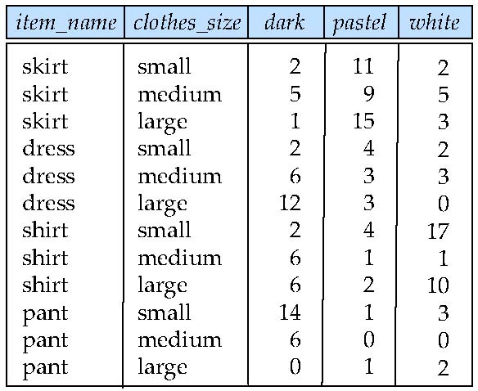
Figure 5.22

Slide 107
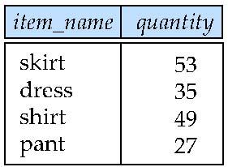
Figure 5.23

Slide 108
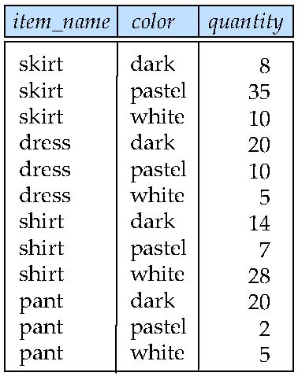
Figure 5.24

Slide 109
Another Recursion Example
Given relation
manager(employee_name, manager_name)
Find all employee-manager pairs, where the employee reports to the manager directly or indirectly (that is manager’s manager, manager’s manager’s manager, etc.)
with recursive empl (employee_name, manager_name ) as (
select employee_name, manager_name
from manager
union
select manager.employee_name, empl.manager_name
from manager, empl
where manager.manager_name = empl.employe_name)
select *
from empl
This example view, empl, is the transitive closure of the manager relation

Slide 110
Merge statement (now in Chapter 24)
Merge construct allows batch processing of updates.
Example: relation funds_received (account_number, amount ) has batch of deposits to be added to the proper account in the account relation
merge into account as A
using (select *
from funds_received as F )
on (A.account_number = F.account_number )
when matched then
update set balance = balance + F.amount

